Slide 1

KEYPOINTS
What is Linux
Requirement of OS
What is OS
Is OS is multitasking
OS Layer
Mode and typs of shell
Diff between open and closed source
Diff between linux and windows
Linux Distributers

Slide 2

What is Linux
Linux is an OS
Developed By Linux Torvalds (1991)

Slide 3

Requirement of OS and What is OS
To Run Application.
Requirement of resources to run application
RAM,CPU,Disk provided by OS to run app.
Interface between user and hardware.
It is platfrom to run software or programs and it also manages computer harware.
Kernel is a core part of OS or heart of OS which have access to all the hardware of the system.
Need intermediate to talk with kernel (Assembly Language) as it is in low level language. This is shell (As a interpreter or it is also a program).
Linux is a Kernel.
7 Main distributors are there, but will study with our requirement.

Slide 4
OS Layer
User Layer
Application Layer
Shell
Kernel
Hardware
Notes:
This is another option for an Overview slide.

Slide 5
Difference Between Open And Closed Source
Open Source
Free
Source Code Available
Highly Customizable
Reliable(Trustworthy)
Secure (Customize is secure)
Redistribute
Fast Develop
Closed Source
Paid
Source Code is Not Available
Not Fully Customizable
Terms And Condition
Not Fully Secure
Not Redistributed
Slow Develop
Notes:
What will the audience be able to do after this training is complete? Briefly describe each objective how the audience will benefit from this presentation.

Slide 6
Difference Between Linux And Windows
Linux
Open Source
More than 100+ flavours
Secure
Reliable
Hardware Independent (It can run 256MB Ram (Puppy Linux))
Performance Fast
Graphics Not Reliable
Windows
Closed Source
One Flavour
Not Fully Secure
Not Fully Reliable
Hardware Dependent
Performance Slow
Graphics Reliable
Notes:
What will the audience be able to do after this training is complete? Briefly describe each objective how the audience will benefit from this presentation.

Slide 7
Linux Distributors
Fedora
Debian
RHEL
Centos
Ubuntu
Kali
Notes:
Use a section header for each of the topics, so there is a clear transition to the audience.

Slide 8
Installation Of RHEL And Centos
Keywords
What resources we need to install the OS
Dedicated Server – A machine which complete hardware is dedicated to one OS. So if we need to install multi OS we need virtualization.
Challenges in Dedicated Server
Cost High
Resource Wastage
Time Taking Process
Not Provision (Provision setup of a machine)
Provisioning is the process of setting up IT infrastructure

Slide 9
OS Architecture
APP
OS
Hardware
RAM
DISK
CPU
NIC

Slide 10
Virtulization
Advantage
Cost Low
Resource Share (No Resource Wastage)
Less time taken to install to Provision the VM.

Slide 11
Virtualization Architecture
VM 1
VM 2
Vram,vcpu,vdisk,vnic
Vram,vcpu,vdisk,vnic
HyperVisor (Virtualzation)
Windows (OS)
Hardware

Slide 12
HyperVisior is a virtulization tool
Types Of Hypervisior
KVM (Open Source)
RHEV
Vmware
Oracle Virtualbox
Command Covered
Whoami
Hostname
Hostnamectl
Exec bash

Slide 13
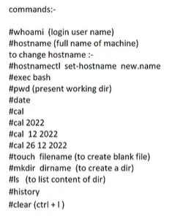

Slide 14
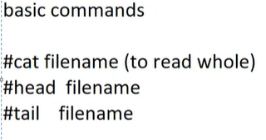
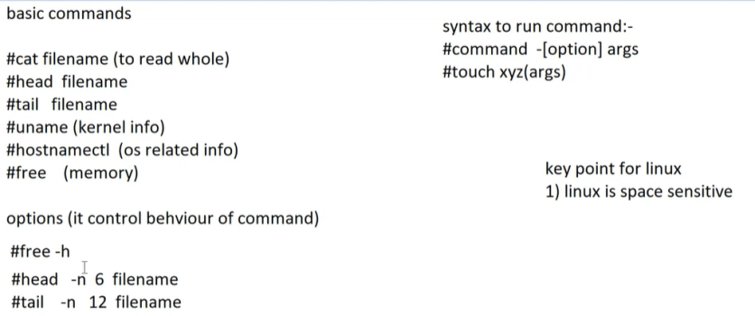

To Read Files And System Info

Slide 15
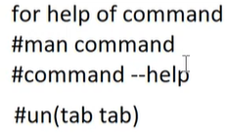
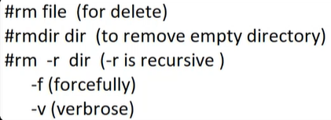
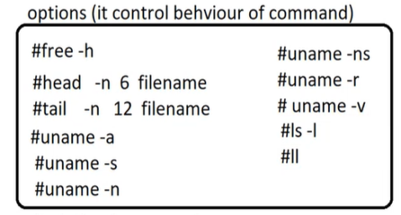
For Help

Slide 16

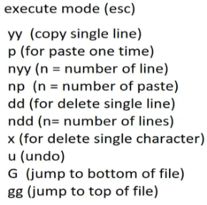
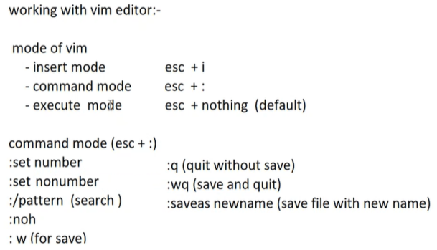
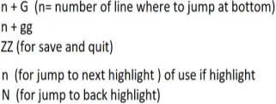
Editors (To edit the file)
# gedit (graphical edit if gui is available)
# vi (cli editor)
# vim
# nano
# vim (non exist file name - create a new file after saving)

Slide 17
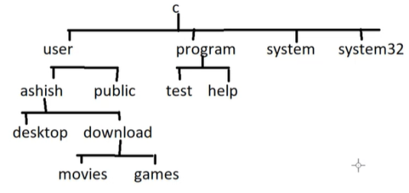
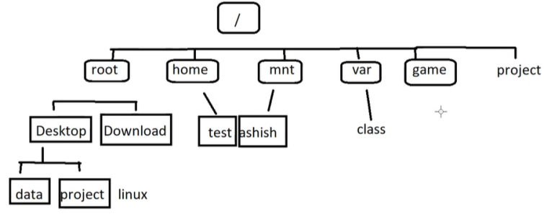
Path
Windows
Linux

Slide 18
